Slide 1
Unit 4
Extending the Number System

Slide 2
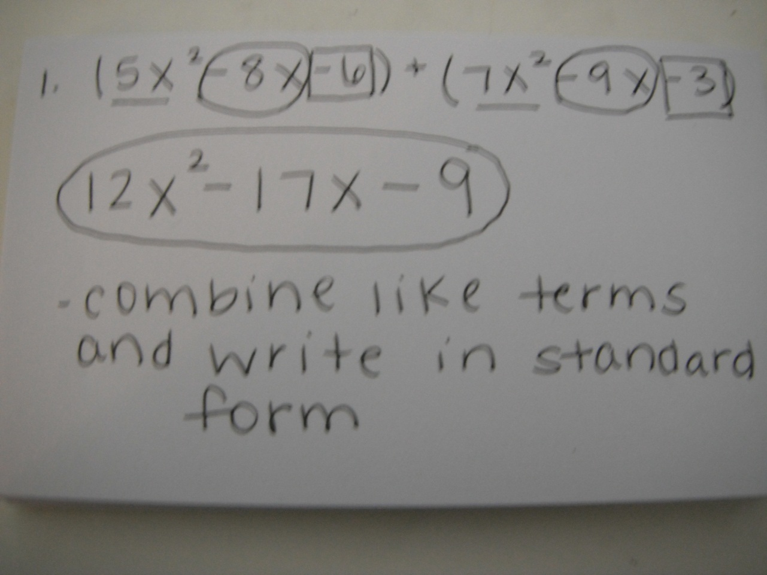

1. Add or Subtract:

Slide 3
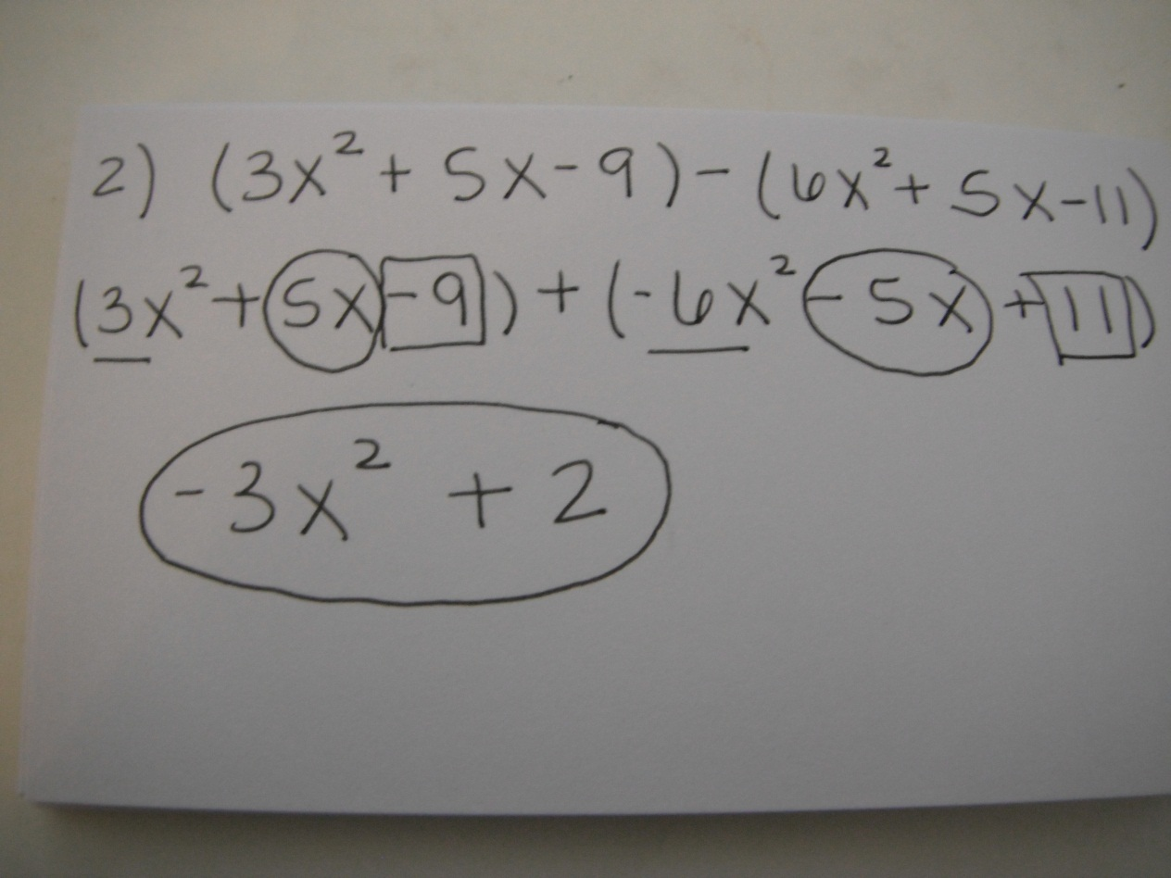
2. Add or Subtract:

Slide 4
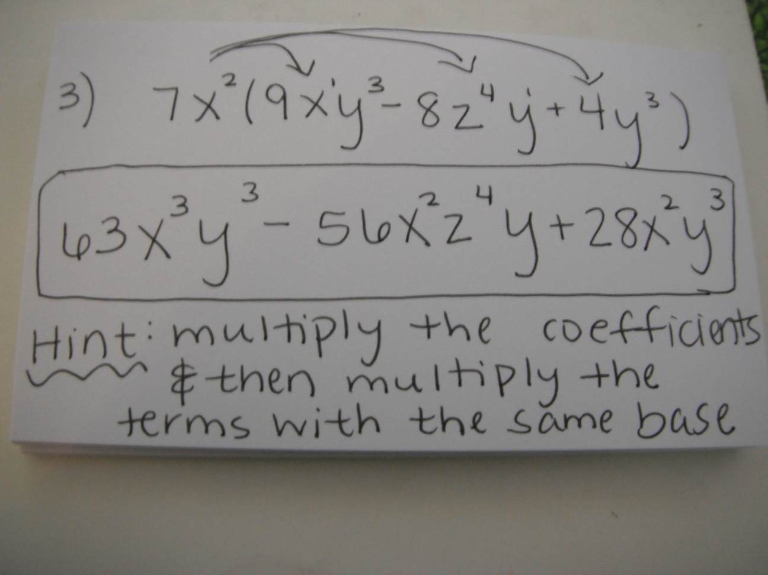
3. Multiply

Slide 5
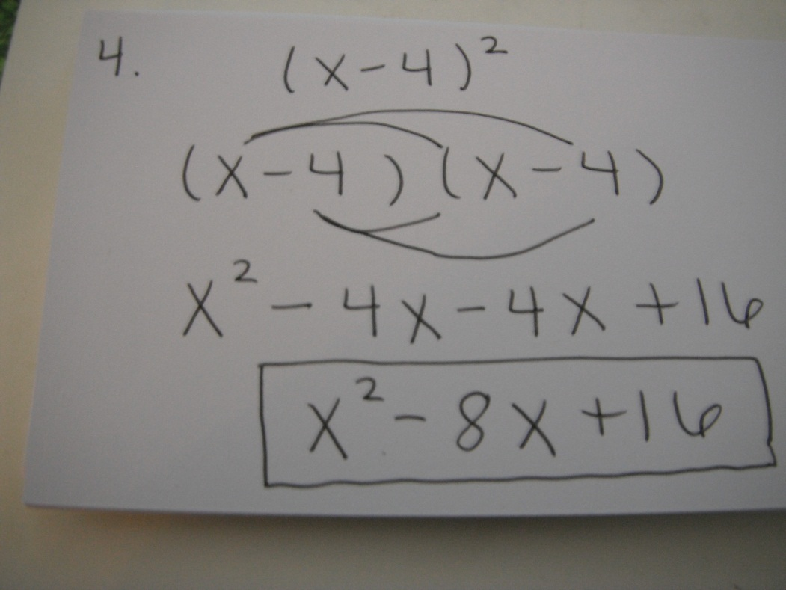
4. Multiply

Slide 6
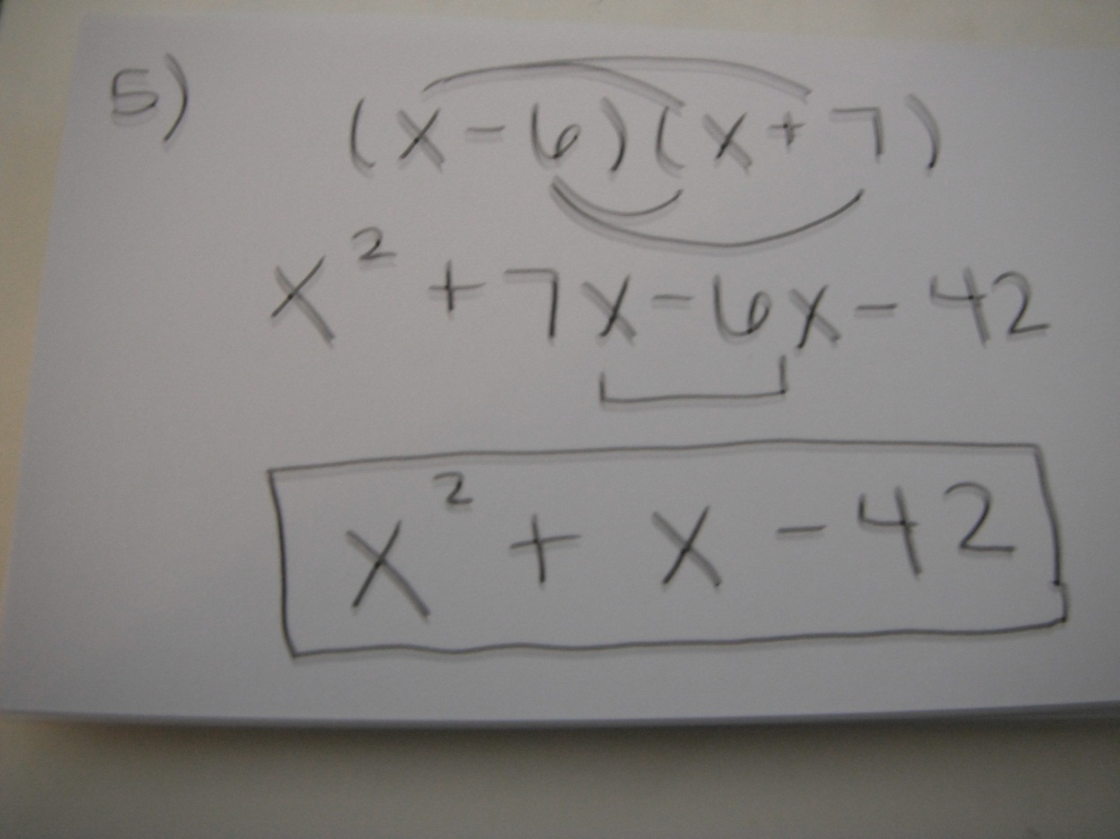
5. Multiply

Slide 7
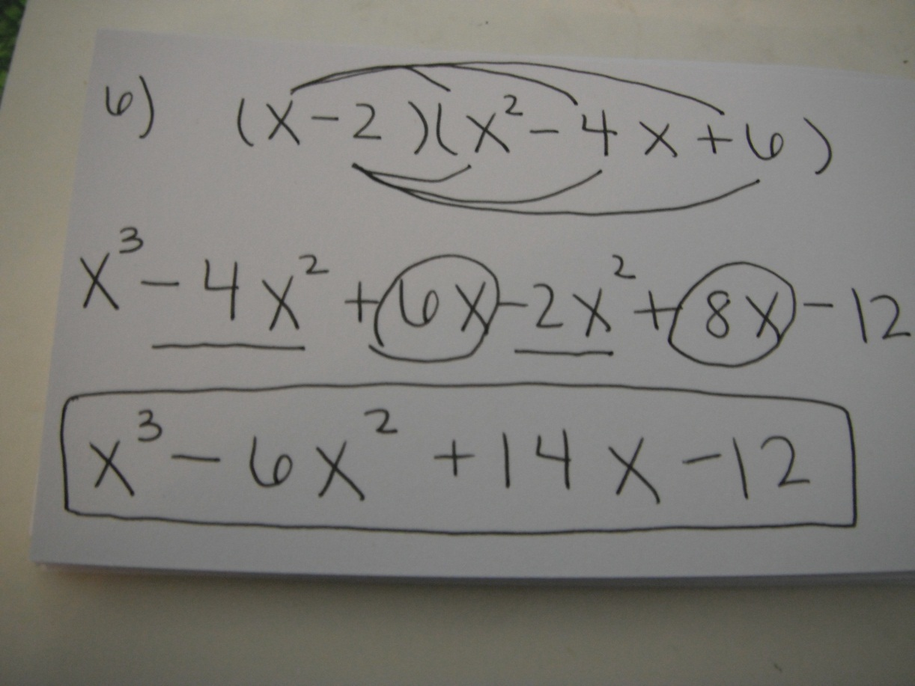
6. Multiply

Slide 8
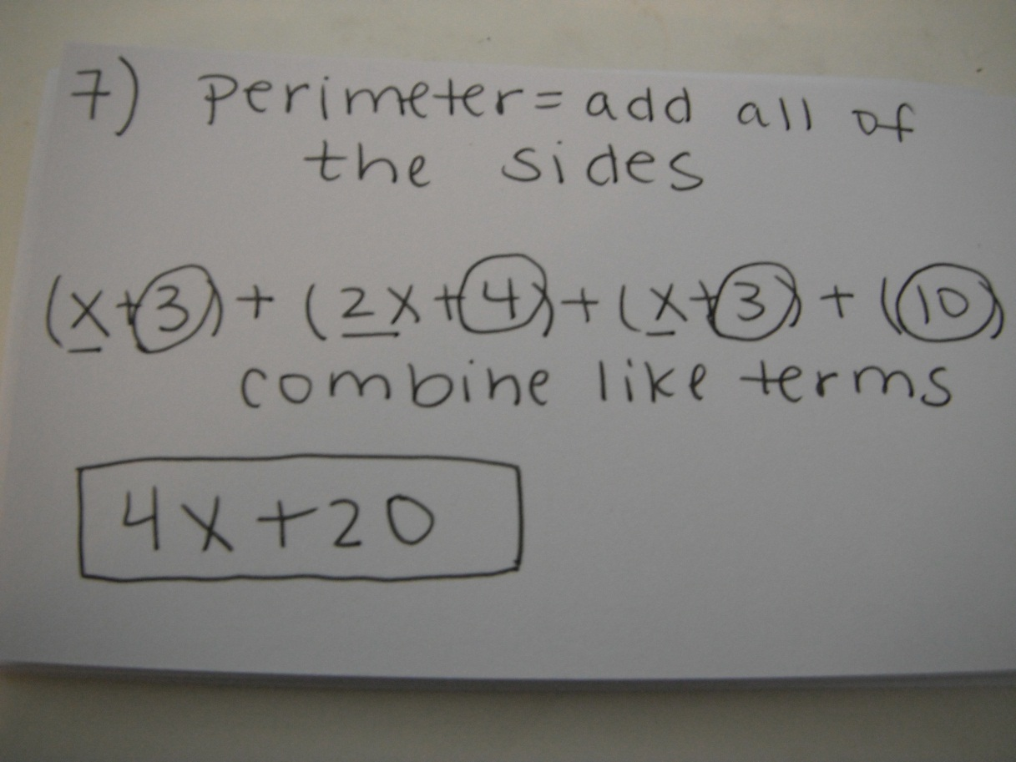
7. Give the perimeter of the deck shown below.
2x + 4
x +3
x +3
10

Slide 9
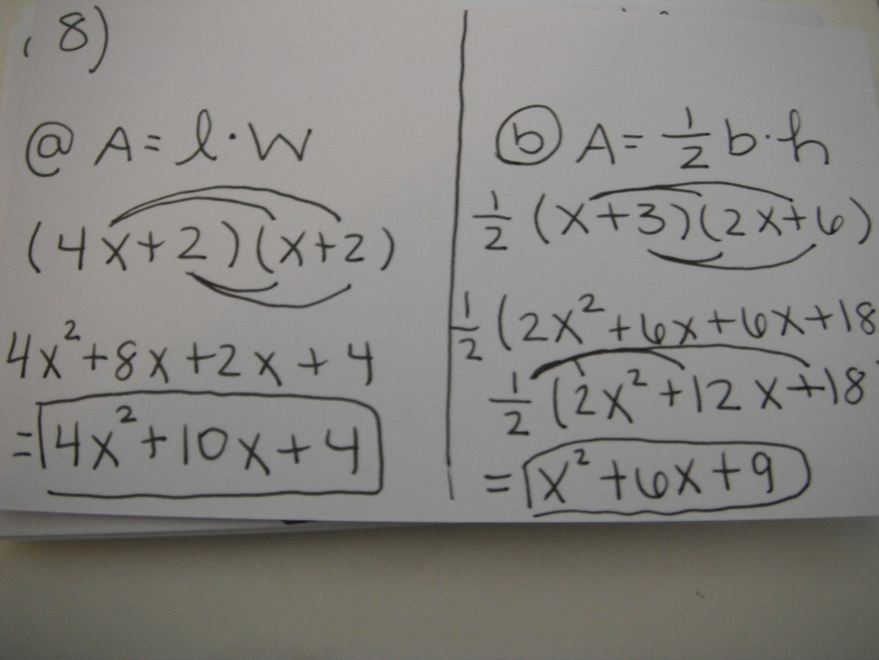
8. Find the area of the figures
a) b)
x+3
X + 2
4x+2
2x+6

Slide 10
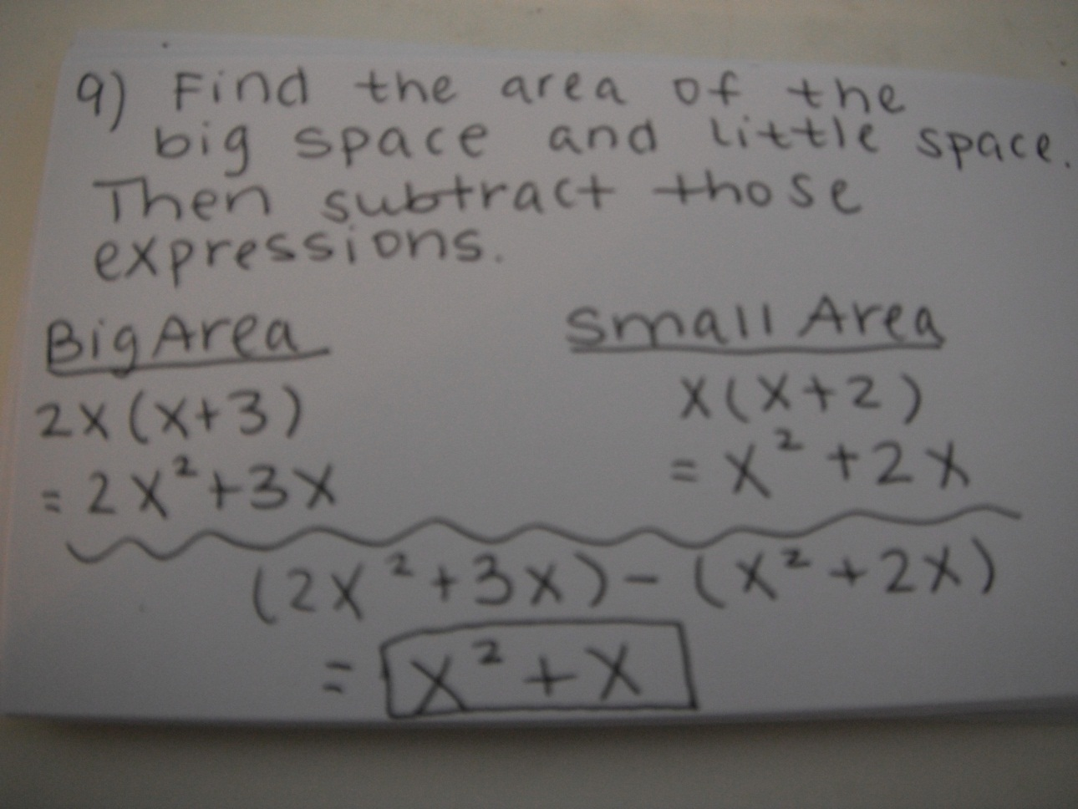
9. Find the area of the white space.
(x + 2)
2x
x
(x + 3)

Slide 11
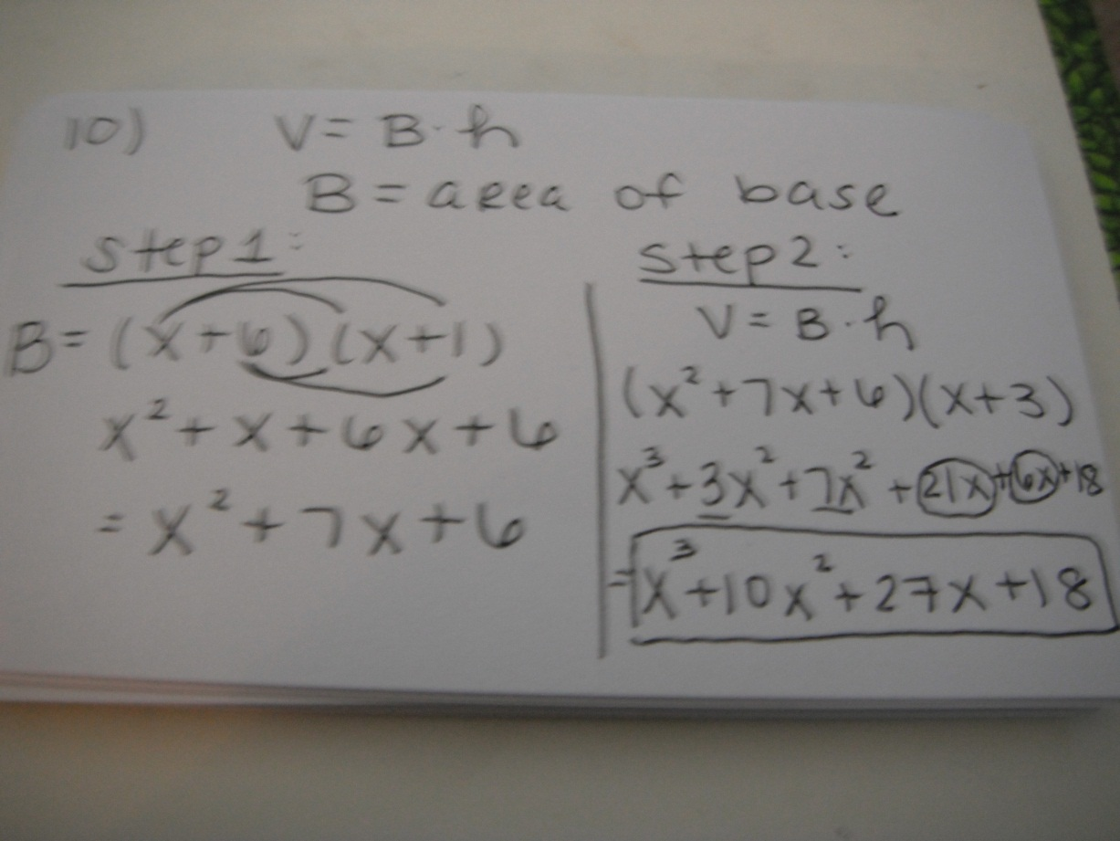
10. Find the volume of the rectangular prism.
x +3
x +1
x +6

Slide 12
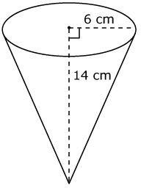
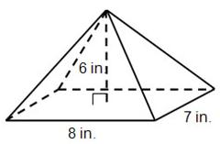
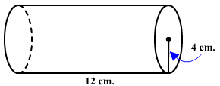
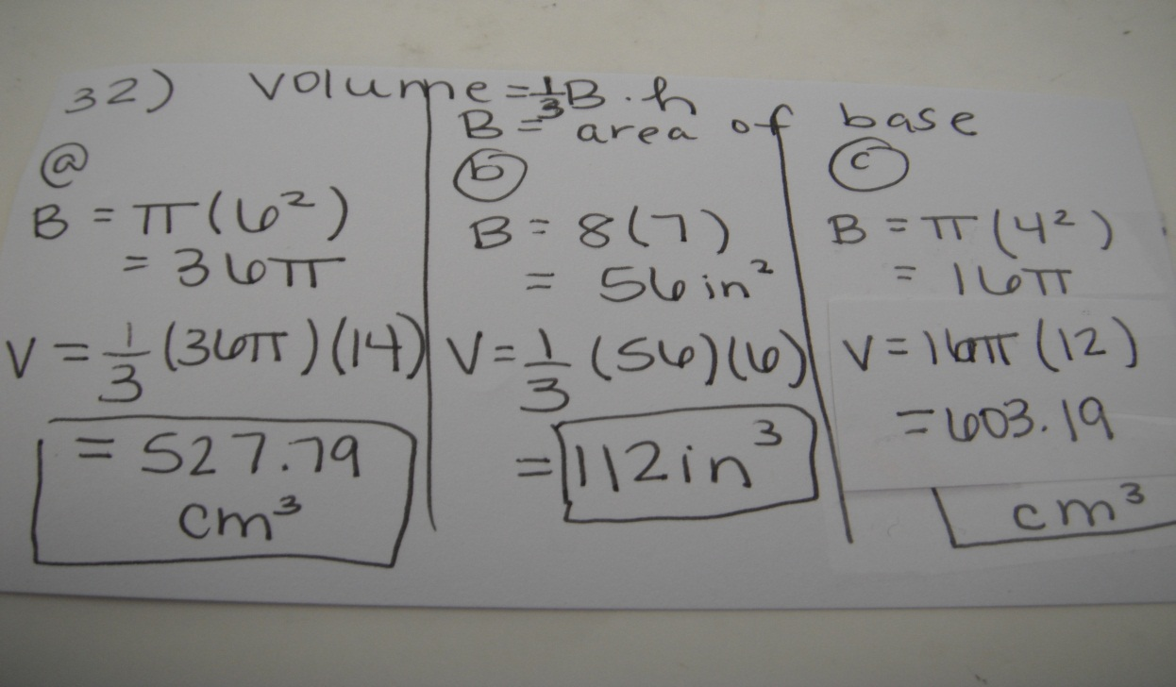
32. Find the volume of each figure below.
a) b) c)

